Slide 1

Software requirements (swr302)
Documenting the requirements (chapter 10)

Slide 2
Why is documenting the requirements?
The result of requirements development is a documented agreement among stakeholders about the product to be built.
The product’s functional and nonfunctional requirements often are stored in a software requirements specification, or SRS, which is delivered to those who must design, build, and verify the solution.
You can represent software requirements in several ways, including:
Well-structured and carefully written natural language.
Visual models that illustrate transformational processes, system states and changes between them, data relationships, logic flows, and the like.
Formal specifications that define requirements by using mathematically precise specification languages.

Slide 3
The software requirements specification
It is sometimes called a business requirements document (BRD), functional specification, product specification, system specification, or simply requirements document.
Audiences:
Customers,
Project managers ,
Dev teams, Testers, Maintenance & support staff,
Documentation writers, Training personnel,
Legal staff, Subcontractors,..

Slide 4
The software requirements specification
How many specifications?
How to organize and write SRS
Purpose, how to do?
Labeling requirements
Sequence number
Hierarchical numbering
..
Dealing with incompleteness
User interfaces and the SRS

Slide 5
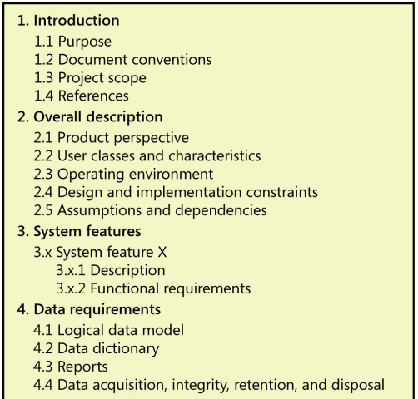
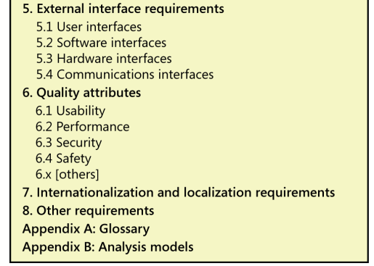
The software requirements specification

Slide 6
Requirements specification on Agile projects
The extent to which just-in-time informal verbal and visual communication between customers and developers can supply the necessary details to permit the correct implementation of each user requirement
The extent to which informal communication methods can keep the team effectively synchronized across time and space
The extent to which it is valuable or necessary to retain requirements knowledge for future enhancement, maintenance, application reengineering, verification, statutory and audit mandates, product certification, or contractual satisfaction
The extent to which acceptance tests can serve as effective replacements for descriptions of the expected system capabilities and behaviors
The extent to which human memories can replace written representations

Slide 7


